Slide 1
Friday, October 1st 2021
Starter: My family
Lesson 4
Numbers

Slide 2
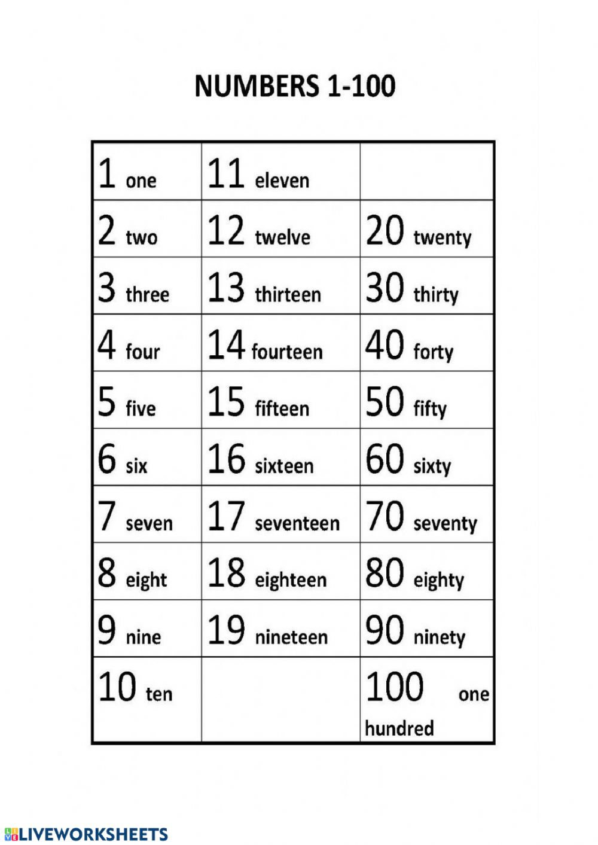

Slide 3
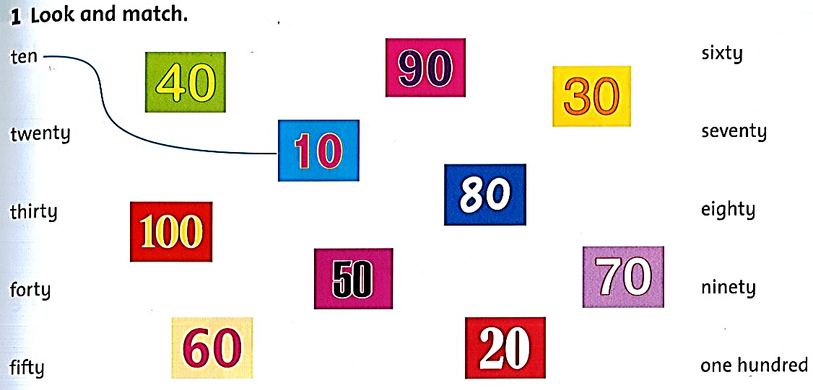

Slide 4
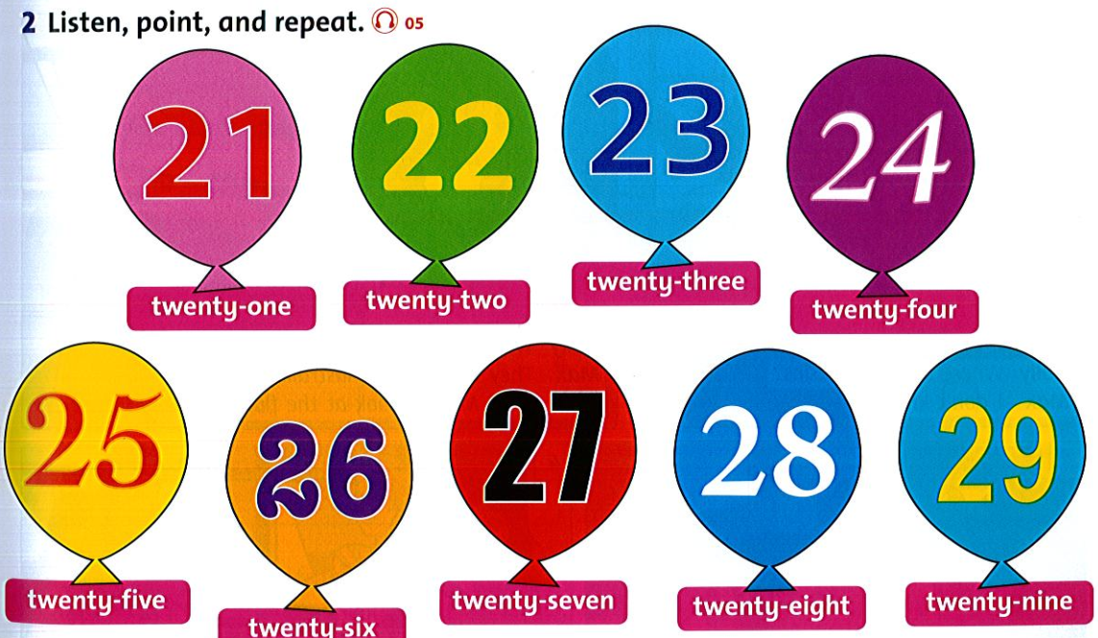

Slide 5
20
20
forty
70
10
eighty
63
31
ninety-four

Slide 6
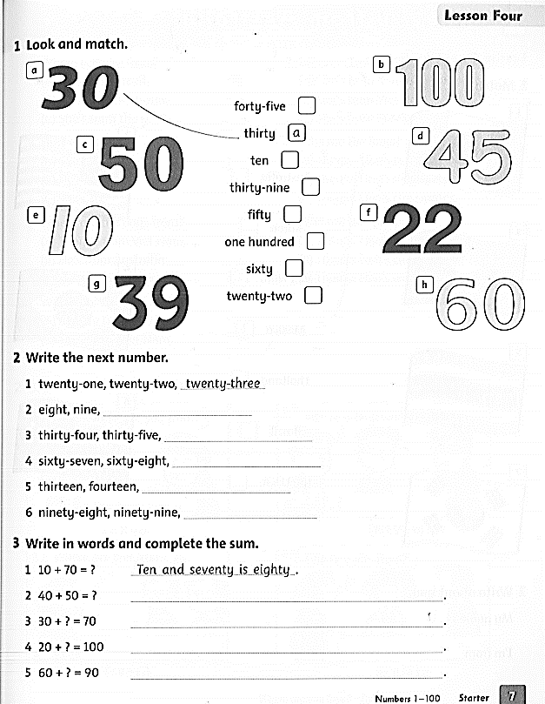
Workbook page 7

Slide 7
d
e
g
c
b
h
f

Slide 8
ten
thirty-six
sixty-nine
fifteen
one hundred

Slide 9
+
=
and
is
Forty and fifty is ninety.
Thirty and forty is seventy.
Twenty and eighty is one hundred.
Sixty and thirty is ninety.

Slide 10
Homework
Do exercise on liveworksheets
https://www.liveworksheets.com/rv103951py
https://www.liveworksheets.com/xp1233402ko

